Slide 1
NFTs
PRICING
USING APIs
Anvitha Chaluvadi and Maria Notarianni
Notes:
Today, we're diving into the world of Non-Fungible Tokens (NFTs), where understanding how they're priced is key for buyers and sellers alike. But it's not always straightforward – NFT prices are influenced by things like rarity, popularity, and cultural relevance.
That's why we're working on a simple tool using machine learning to help people understand how prices work, focusing specifically on Pudgy Penguins on OpenSea.

Slide 2
WHY DO PEOPLE BUY NFTS
Collecting and Ownership
Investment
Supporting Artists and Creators
Virtual Identity and Status
Access to Exclusive Content or Experiences
Speculation and Hype
Notes:
Collecting and Ownership:
Just like collecting physical art or collectibles, some people buy NFTs to own a unique digital asset. NFTs represent ownership of a digital item, whether it's digital art, music, virtual real estate, or other digital creations. Owning an NFT can give collectors a sense of ownership and exclusivity.
Investment:
Some people buy NFTs as an investment opportunity. They believe that the value of certain NFTs will increase over time, similar to traditional art or collectibles. Just like investing in stocks, real estate, or cryptocurrencies, buying NFTs can be seen as a way to potentially profit from price appreciation in the future.
Supporting Artists and Creators:
Buying NFTs can be a way to support artists and creators directly. NFTs allow artists to monetize their digital creations in new ways, bypassing traditional intermediaries like galleries or record labels. By purchasing an artist's NFT, collectors can directly support the artist financially and help them continue to create.
Virtual Identity and Status:
In some cases, owning certain NFTs can confer social status or serve as a symbol of identity within virtual communities. For example, owning rare or prestigious NFTs within a specific online community or metaverse can signal status or membership.
Access to Exclusive Content or Experiences:
Some NFTs come with access to exclusive content or experiences. For example, purchasing an NFT might grant access to virtual events, VIP experiences, or special perks within a particular platform or ecosystem.
Speculation and Hype:
Like any emerging market, speculation and hype can also drive demand for NFTs. Some buyers may be attracted to NFTs simply because they see others profiting from them or because they perceive them as trendy or fashionable.

Slide 3
MOTIVATION & SUMMARY
Objective: To assist new NFT buyers in understanding NFT pricing.
Method: Utilizing a linear regression model, evaluating the predictive power of the Pudgy Penguins traits (features) .
Data Source: API data from the Pudgy Penguins collection on OpenSea.
Flexibility: The project could be adapted for other NFT collections.
PM Comment: Reduce features to improve model predictive power! Narrowing the dataset scope can enhance accuracy.
Notes:
We would like to assist NFT buyers who are new to the market and do not understand NFT pricing very well. Buyers will evaluate individual NFTs, using a supervised learning model that has been deployed on Streamlit. We will also include ETH-USD exchange rates as features in the model and components of our analysis.
The project will utilize API data from one NFT the Pudgy Penguins collection on OpenSea; but, in principle, it could be modified and used for other collections by developers.

Slide 4
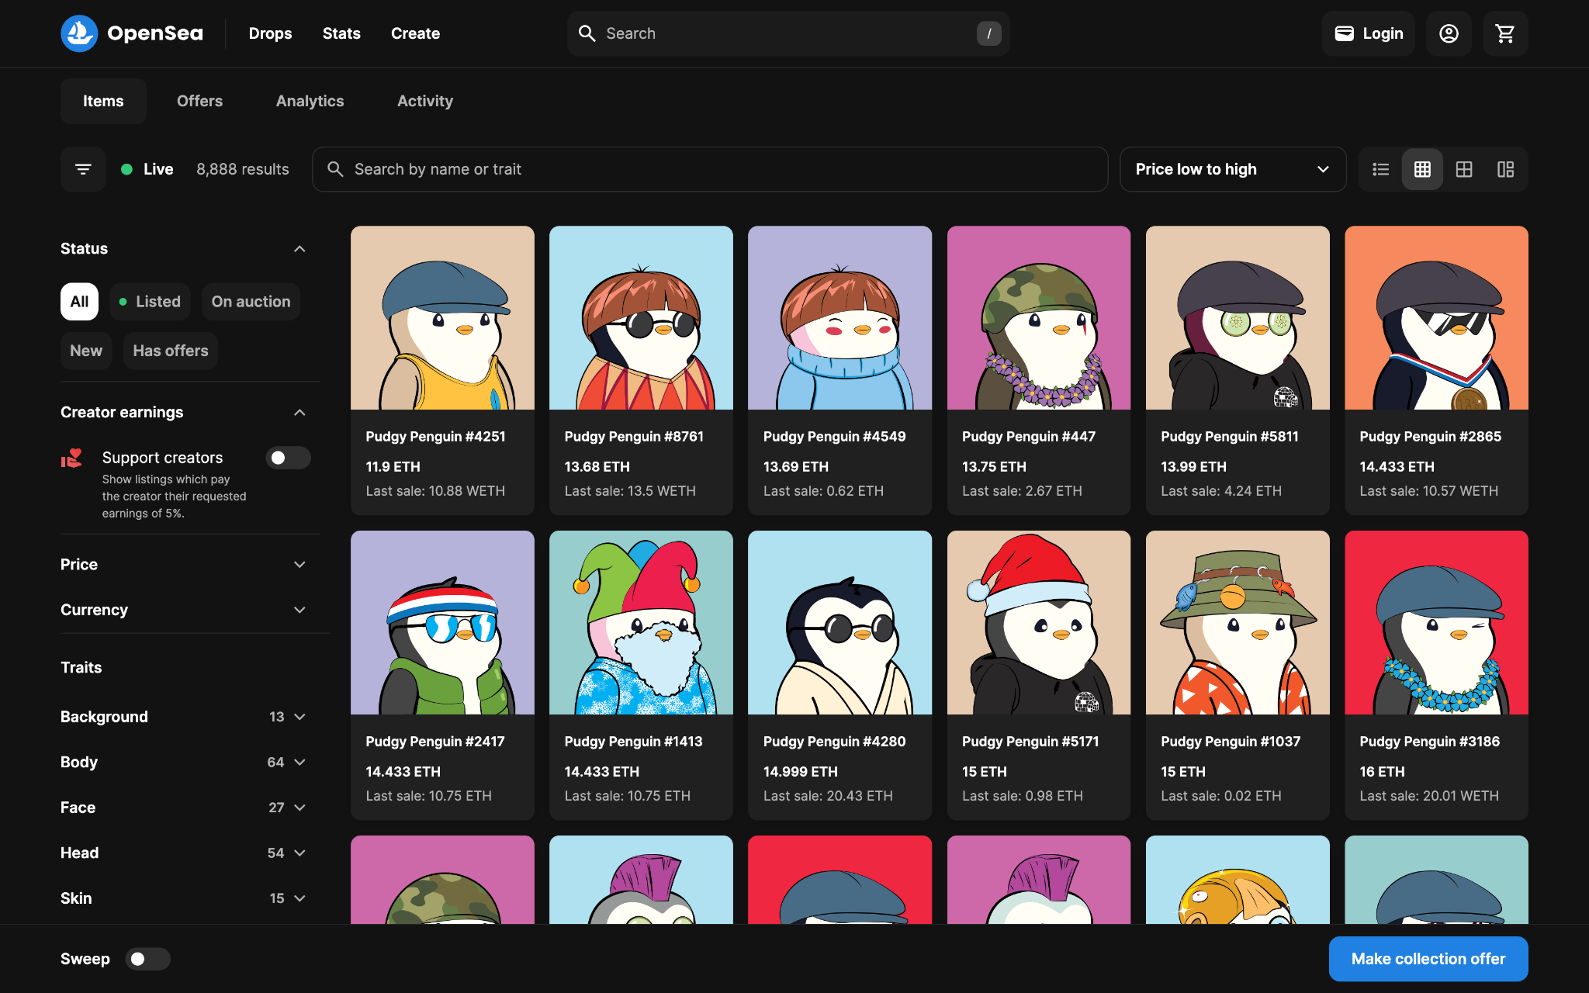
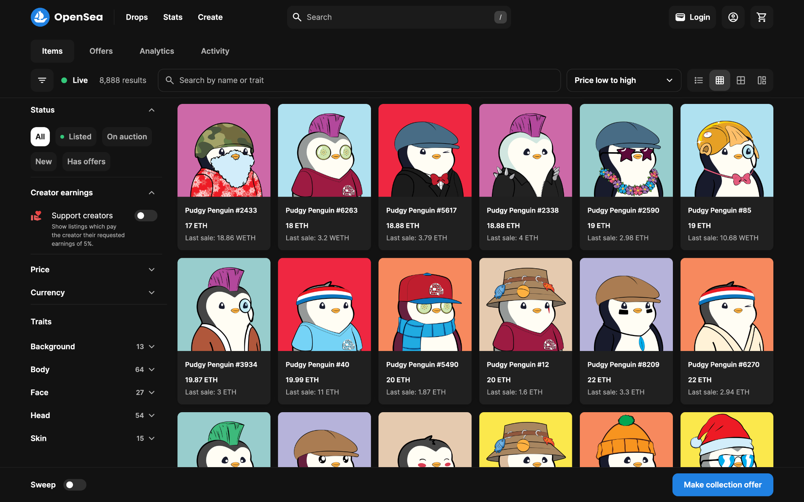
PUDGY PENGUINS
Collection: Pudgy Penguins
Number: 8,888 distinct NFTs
Purpose: Driving Web3 innovation
Values: Representing love, empathy, and positivity
Benefits: Exclusive access to events and experiences for owners
Notes:
Pudgy Penguins is a collection of 8,888 distinct NFTs, driving Web3 innovation through intellectual property and community support. These penguins represent love, empathy, and positivity, offering exclusive benefits to owners, including access to events and experiences.

Slide 5
PUDGY PENGUINS COLLECTION
Volume: 345970.149573
Sales: 78963
Average Price: 4.381421
Number of Owners: 4778
Market Cap: 103268.203657
Floor Price: 12.5 ETH
Floor Price Symbol: ETH
Notes:
Let's dive into some key numbers for the Pudgy Penguins collection:
Volume: Over 345,000 transactions have taken place within the Pudgy Penguins ecosystem.
Sales: There have been nearly 79,000 sales of Pudgy Penguins NFTs.
Average Price: Each Pudgy Penguins NFT sells for approximately 4.38 ETH on average.
Number of Owners: Currently, there are 4,778 proud owners of Pudgy Penguins NFTs.
Market Cap: The total market value of the Pudgy Penguins collection is roughly 103,000 ETH.
Floor Price: The minimum price to buy into the Pudgy Penguins collection is set at 12.5 ETH.
Floor Price Symbol: All prices are denoted in ETH, the primary currency of the Pudgy Penguins marketplace.
These numbers give us a snapshot of the activity and value of the Pudgy Penguins NFT collection in the market.

Slide 6
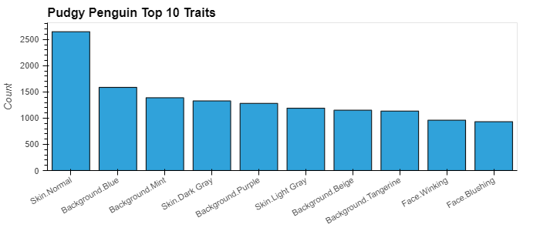
TOP TRAITS
Categories
Background
Skin
Body
Face
Head
Notes:
Alright, let's go over the traits of the Pudgy Penguins collection by category:
In terms of categories, we have Background, Skin, Body, Face, and Head.
Looking at the top 10 traits and their counts, we see some interesting patterns. For example, Skin.Normal is the most common trait, appearing 2,649 times. Background colors like Blue, Mint, and Purple are also quite popular, each appearing over 1,000 times.
Now, let's narrow it down to the top 5 traits in each category:
Background: The top 5 backgrounds are Blue, Mint, Purple, Beige, and Tangerine.
Skin: The most common skin trait is Normal, followed by Dark Gray and Light Gray. (normal: I think this means black and white like a penguin)
Body: Among body traits, Shirt Blue takes the lead, followed by Kimono Brown and Shirt Red.
Face: When it comes to faces, Winking and Blushing are the top contenders, showing up frequently in the collection.
Head: Finally, in terms of headwear, we see Headband, Flat Cap Blue, and Bucket Hat Green making the top of the list.
These traits give us a glimpse into the diversity and preferences within the Pudgy Penguins collection.
top 10 traits (and counts)
Skin.Normal 2649
Background.Blue 1587
Background.Mint 1389
Skin.Dark Gray 1329
Background.Purple 1282
Skin.Light Gray 1189
Background.Beige 1152
Background.Tangerine 1135
Face.Winking 961
Face.Blushing 932
top 5 backgrounds traits
Blue 1587.0
Mint 1389.0
Purple 1282.0
Beige 1152.0
Tangerine 1135.0
top 5 skin traits
Normal 2649.0
Dark Gray 1329.0
Light Gray 1189.0
Maroon 731.0
Olive Green 705.0
top 5 body traits
Shirt Blue 290.0
Kimono Brown 268.0
Shirt Red 259.0
Turtleneck Green 254.0
Scarf Green 250.0
top 5 face traits
Winking 961.0
Blushing 932.0
Normal 864.0
Circle Glasses 768.0
Cute 588.0
top 5 head traits
Headband 357.0
Flat Cap Blue 355.0
Bucket Hat Green 349.0
Backwards Hat Red 294.0
Hat Blue 286.0

Slide 7

DATA CLEANUP
OpenSea APIs
Traits Summary Counts
NFT Sales Events
Individual NFT Information
Pagination (50 per page)
Dataframe Components
Events Data
NFT Token (nft.identifier)
Closing Date (for ETH comparison)
Payment Quantity (wei, y-hat)
Individual NFT Info
Extracted Traits for Each NFT (dimension, X)
Background
Skin
Body
Face
Head
Exporting Data
(static → model)
to_csv
Notes:
We used several APIs to gather essential data for our analysis:
Opensea APIs: These APIs were pivotal in directly accessing data from the Pudgy Penguins collection on OpenSea. They provided us with real-time insights into the collection's dynamics.
Traits Summary Counts: With this API, we obtained summary counts of different traits within the Pudgy Penguins collection. This helped us grasp the distribution of traits among the NFTs.
NFT Sales Events: Using this API, we tracked sales events for the Pudgy Penguins NFTs. It allowed us to monitor the transaction history of individual NFTs.
Individual NFT Information: This API furnished us with detailed information about each individual Pudgy Penguins NFT, including its unique identifier, closing date, payment quantity, and more.
Now, let's discuss the components of our dataframe:
Events Data: This section contained comprehensive details about sales events and transactions.
NFT Token (nft.identifier): We assigned unique identifiers to each Pudgy Penguins NFT.
Closing Date (for ETH comparison): This enabled us to compare prices in ETH by referencing the date of each transaction's closure.
Payment Quantity (wei, y-hat): We quantified the cryptocurrency payment for each NFT, measured in wei.
Pagination (50 per page): To streamline data management, we structured our data into pages, each comprising 50 sales.
Individual NFT Info: Detailed insights into each Pudgy Penguins NFT were encapsulated here.
Traits for Each NFT: We meticulously cataloged the traits associated with each NFT.
Exporting Data (static): Finally, we exported our data using the to_csv command, generating a static file for further analysis.
Through the seamless integration of APIs and the meticulous organization of data frame components, we gained profound insights into the intricacies of the Pudgy Penguins collection.

Slide 8
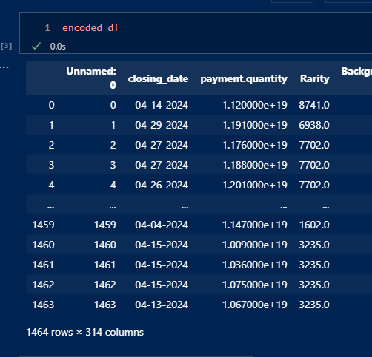
ENCODED DATA

Slide 9
LINEAR REGRESSION MODEL
R² EVALUATION
R²
“Whereas correlation explains the strength of the relationship between an independent and a dependent variable, R-squared explains the extent to which the variance of one variable explains the variance of the second variable. So, if the R² of a model is 0.50, then approximately half of the observed variation can be explained by the model’s inputs.” (Source: Investopedia)
Training Dataset (Descriptive Value)
R-squared (R²) Score: 0.6909513484448644
This means that traits strongly describes price in training data! (Only 30% noise!)
Testing Dataset (Predictive Value)
R-squared (R²) Score: -1.4725014974827797e+26
This means the model cannot predict anything! But why…?
Notes:
So, when we talk about R-squared, think of it as a measure that tells us how much of the variation in one variable can be explained by another variable.
For instance, if we have an R-squared value of 0.50, it means that roughly half of the observed variation in one variable can be explained by the model's inputs.
Now, looking at our training dataset, we have an R-squared score of about 0.69. This indicates that the traits we've identified strongly describe the price in the training data. In fact, there's only about 30% noise in there, which is pretty good!
But then, when we move to our testing dataset, things take a bit of a turn. The R-squared score is incredibly low, in fact, it's negative! Specifically, it's -1.47e+26. This basically tells us that our model is struggling to predict anything from this dataset.
Now, the big question is, why is this happening? That's something we need to dive deeper into.

Slide 10
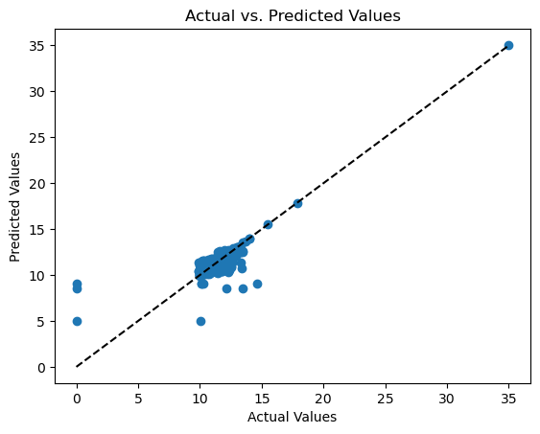
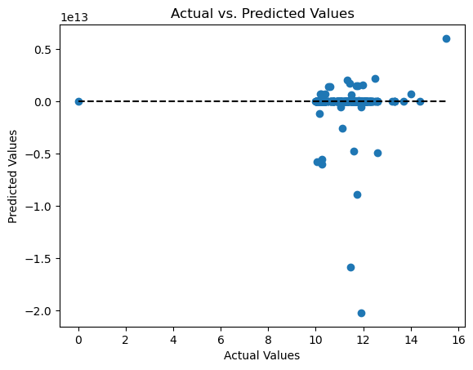

RESULTS
MODEL EVALUATION METRICS
Training Dataset
Testing Dataset
Notes:
What theses type of graphs explain: The scatter train plot and dashed line helped us see how well the model was working. We noticed it was making accurate predictions when points were close to the line. However, when the points were spread out, it showed us where we needed to improve.
So, let's talk about our linear regression model. As noted on the previous slide, initially, it did a great job describing how traits relate to price in our training dataset, scoring a solid R-squared (R²) of 0.69.
But when we put it to the test with the testing dataset, things didn't go as planned. The R-squared score dropped dramatically to a really low -1.47e+26, which was a bit of a shock.
But all in all, the model can describe the dataset, but it cannot predict
What's the next step? Well, we need to investigate further to make our model better at predicting. It's all about fine-tuning and refining to get those predictions spot on.

Slide 11
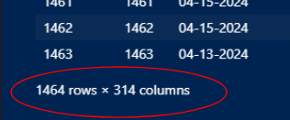
DISCUSSION & POSTMORTEM
Challenges in Model Performance Assessment:
Issue: High dimensionality with limited data points
Ideal Scenario:
Increased dataset size
Reduce dimensions
Future Avenues for Solving This Problem:
Converting ETH-USD
Fixing API issues
Isolating traits
Consider focusing on the top 10 traits
Addressing Overfitting:
Attempted PCA feature reduction, but the explained variance ratio was low
Pulling more data to address overfitting in Linear Regression, but conversion fluctuations in ETH-USD impact outcomes
Notes:
We've faced two main challenges: a lot of different features and not enough data points. Ideally, we'd have more data and fewer features. Sean has stressed the importance of getting a much larger dataset to help with this.
Looking forward, we're considering a few ways to tackle this. We might change how we handle ETH-USD, fix some issues with our API, and focus on specific traits. One idea is to concentrate on the top 10 traits to simplify our analysis.
Now, let's talk about overfitting. We tried something called PCA to reduce overfitting, but it didn't work as well as we hoped. We're also trying to get more data for Linear Regression to help with overfitting. However, we need to be aware that changes in ETH-USD could affect our results.
So, why is our model struggling? It's mainly because we have a lot of features (over 300) and not enough data points (less than 1500). Ideally, we'd have a lot more data and fewer features, like Sean suggested.
To sum up, we're working on these challenges and looking for ways to improve our model's performance.
Future avenues for solving this problem!
converting ETH-USD
fixing API issues
Isolating traits (maybe top 10 traits?)
We attempted to address overfitting with PCA feature reduction, but the explained variance ratio was very low.
We would pull more data to address LR overfitting, but without the ETH-USD conversion, it would impact outcomes related to big conversion fluctuations in the past year.
Why is the model garbage? Because there are too many features (300+) and limited elements in the dataset (<1500). Ideally, there would be more elements and fewer features. (Sean says MUCH more.)

Slide 12
SHOUT OUTS!
Notes:
Smerling
Kevin
Sean

Slide 13
QUESTIONS?

Slide 14
LINKS
Deployed Application
OpenSea
OpenSea: Pudgy Penguin
GitHub Repository
Project 3 Repository
Data Cleaning
Machine Learning

